Slide 1
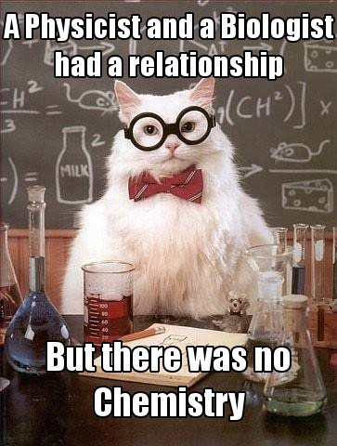

Slide 2
Learning Targets
I can use correct numbers of significant figures and units in both measurements and calculations.
I can accurately measure mass and volume using a balance and a graduated cylinder.
Notes:
Start on Page 7 in Matter & Measurement Unit Booklet

Slide 3
The Metric System Review
Table 1.1: Measurements and their base units
Measurement | Base Unit
Mass
Volume
Length
Energy
Time
Quantity of Matter

Slide 4
The Metric System Review
Table 1.1: Measurements and their base units
Measurement | Base Unit
Mass | Grams
Volume
Length
Energy
Time
Quantity of Matter

Slide 5
The Metric System Review
Table 1.1: Measurements and their base units
Measurement | Base Unit
Mass | Grams
Volume | Liters
Length
Energy
Time
Quantity of Matter

Slide 6
The Metric System Review
Table 1.1: Measurements and their base units
Measurement | Base Unit
Mass | Grams
Volume | Liters
Length | Meters
Energy
Time
Quantity of Matter

Slide 7
The Metric System Review
Table 1.1: Measurements and their base units
Measurement | Base Unit
Mass | Grams
Volume | Liters
Length | Meters
Energy | Joules
Time
Quantity of Matter

Slide 8
The Metric System Review
Table 1.1: Measurements and their base units
Measurement | Base Unit
Mass | Grams
Volume | Liters
Length | Meters
Energy | Joules
Time | Seconds
Quantity of Matter

Slide 9
The Metric System Review
Table 1.1: Measurements and their base units
Measurement | Base Unit
Mass | Grams
Volume | Liters
Length | Meters
Energy | Joules
Time | Seconds
Quantity of Matter | Moles

Slide 10
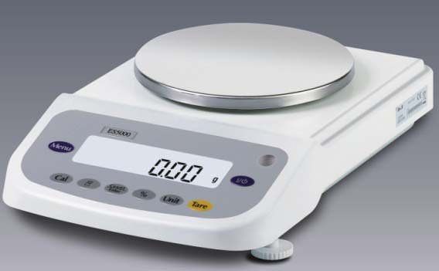
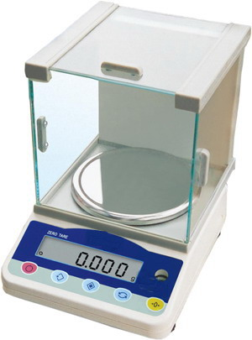
Significant Figures
Reflect the precision of the instrument used to measure something.

Slide 11
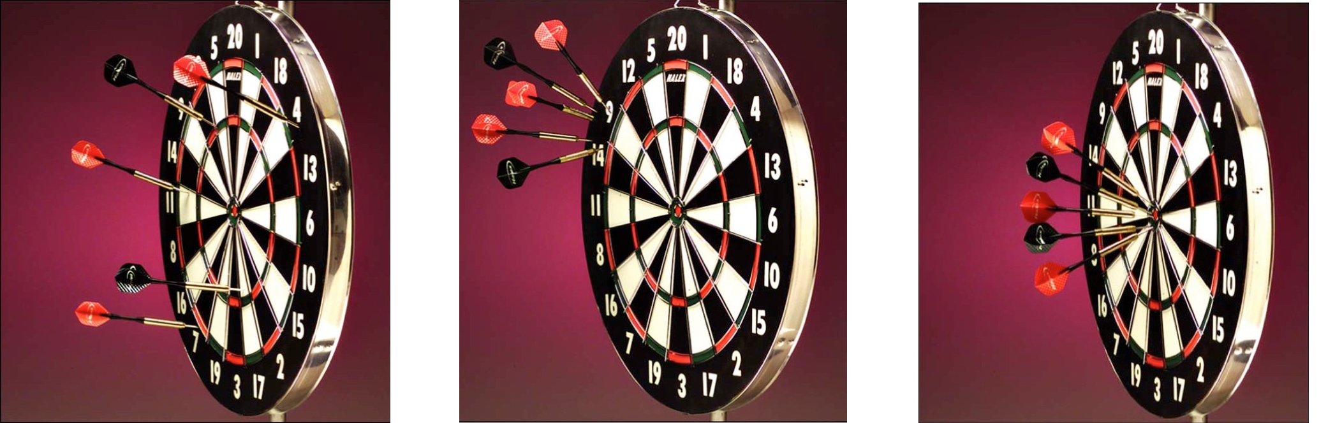
Significant Figures
Accuracy versus Precision
Low Accuracy
Low Precision
Low Accuracy
High Precision
High Accuracy
High Precision
Notes:
See page 7 in booklet

Slide 12
Using Measuring Devices Accurately
Notes:
See page 8 in booklet

Slide 13
Using Measuring Devices Accurately

Slide 14
How do I find the number of sig figs in a measurement I’ve been given?
Table 1.3: Rules of counting significant figures in a given measurement
Rule # | Examples
1.All non-zero digits are significant. | 125 m 3.84 X 10⁴ J
2.Zeros in the middle of a measurement are significant. | 2730.78 m 1.009 g
3.Zeros at the beginning of a measurement are not significant. | 0.0076 mL 0.00000004 g
4.Zeros at the end of a measurement and after a decimal point are significant | 15.0 mL 13.40 g
5.Zeros at the end of a number and before an implied decimal point may or may not be significant. | 3400 kg 3400. kg
6.Some measurements are exact and have an infinite number of significant figures. | Number of people 100 cm = 1 m In a room
Notes:
See page 8 in the booklet

Slide 15
Examples: Number of Significant Figures (sig figs). Record how many sig figs each number has.
1. 892.3 g (4 sig figs)
2. 1405.3 m (5)
3. 12.220 km (5)
4. 0.0002 L (1)
5. 0.0150 (3)

Slide 16
Answers for examples
4 sig figs
5 sig figs
5 sig figs
1 sig fig
3 sig figs

Slide 17
You Try: How many Significant Figures does each number have and what measurement does the unit represent?
1. 912.1 moles
2. 9.0 mg
3. 4303.1 mL
4. 8.00 cm

Slide 18
If I’m doing math with measurements, how do I know how many sig figs the answer must have?
Table 1.3: Rules of counting significant figures in a given measurement
Math Operation | Rule | Example
Adding or Subtracting | The answer can have no more digits to the right of the decimal point than there are in the measurement with the smallest number of digits to the right of the decimal point. | 3.95 g 2.879 g + 213.6 g 220.429 g
Multiplying or Dividing | The answer can have no more significant figures than there are in the measurement with the smallest number of significant figures. | 12.257 cm x 1.162 cm = 14.2426340 cm²
Notes:
`See page 9 in the booklet

Slide 19
Rounding Answers
When rounding numbers, the last digit to be retained (displayed) is increased by one only if the following digit is 5 or greater.

Slide 20

Percent (%) Error

